Slide 1
Exercises
Write a recursive program that simulates the execution of n nested loops from 1 to n. Examples:
1 1 1
1 1 2
1 1 3
1 1 1 2 1
n=2 -> 1 2 n=3 -> ...
2 1 3 2 3
2 2 3 3 1
3 3 2
3 3 3

Slide 2
Exercises (2)
Write a recursive program for generating and printing all the combinations with duplicates of k elements from n-element set. Example:
n=3, k=2 → (1 1), (1 2), (1 3), (2 2), (2 3), (3 3)
Modify the previous program to skip duplicates:
n=4, k=2 → (1 2), (1 3), (1 4), (2 3), (2 4), (3 4)
Write a recursive program for generating and printing all permutations of the numbers 1, 2, ..., n for given integer number n. Example:
n=3 → {1, 2, 3}, {1, 3, 2}, {2, 1, 3}, {2, 3, 1}, {3, 1, 2},{3, 2, 1}

Slide 3
Exercises (3)
Write a recursive program for generating and printing all ordered k-element subsets from n-element set (variations V^{k}_{n}).
Example: n=3, k=2, set = {hi, a, b} =>
(hi hi), (hi a), (hi b), (a hi), (a a), (a b), (b hi), (b a), (b b)
Write a program for generating and printing all subsets of k strings from given set of strings.
Example: s = {test, rock, fun}, k=2
(test rock), (test fun), (rock fun)

Slide 4
Exercises (4)
We are given a matrix of passable and non-passable cells. Write a recursive program for finding all paths between two cells in the matrix.
Modify the above program to check whether a path exists between two cells without finding all possible paths. Test it over an empty 100 x 100 matrix.
Write a recursive program to find the largest connected area of adjacent empty cells in a matrix.
* We are given a matrix of passable and non-passable cells. Write a recursive program for finding all areas of passable cells in the matrix.

Slide 5
Exercises (5)
* Write a program to generate all permutations with repetitions of given multi-set. For example the multi-set {1, 3, 5, 5} has the following 12 unique permutations:
{ 1, 3, 5, 5 } { 1, 5, 3, 5 }
{ 1, 5, 5, 3 } { 3, 1, 5, 5 }
{ 3, 5, 1, 5 } { 3, 5, 5, 1 }
{ 5, 1, 3, 5 } { 5, 1, 5, 3 }
{ 5, 3, 1, 5 } { 5, 3, 5, 1 }
{ 5, 5, 1, 3 } { 5, 5, 3, 1 }
Ensure your program efficiently avoids duplicated permutations. Test it with { 1, 5, 5, 5, 5, 5, 5, 5, 5, 5, 5, 5, 5, 5, 5, 5, 5, 5, 5, 5, 5, 5, 5, 5, 5, 5, 5, 5, 5, 5, 5 }.
Hint: http://hardprogrammer.blogspot.com/2006/11/permutaciones-con-repeticin.html

Slide 6
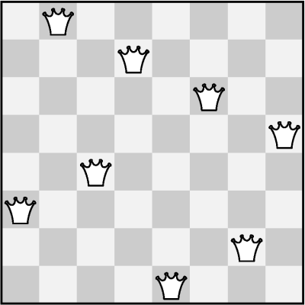
Exercises (6)
* Write a recursive program to solve the "8 Queens Puzzle" with backtracking. Learn more at: http://en.wikipedia.org/wiki/Eight_queens_puzzle

